Slide 1
INVENTORY MANAGEMENT SYSTEM
GROUP : 6

Slide 2
Team members
Employee Id | Name
2498849 | Kurapati Sampath Kumar
2500493 | Kunamneni Vijayalakshmi
2500484 | BHADINENI NARENDRA
2498535 | Swati Pravin Gavate
2498915 | Ummadi Varalakshmi
2498789 | Sonali Bhanudas Mhatre
2498300 | Ramavath Ganesh Nayak
2498772 | Sinchana V
2499000 | Ashutosh Kumar Tiwari
2498890 | MD Ashif Ali
2499330 | K Bhanu Prakash

Slide 3
Frontend Team Backend Team
Bhadineni Narendra
Swati Pravin Gavate
Sonali Bhanudas Mhatre
Ashutosh Kumar Tiwari
Kurapati Sampath Kumar
Ummadi Varalakshmi
Ramavath Ganesh Nayak
MD Ashif Ali
Kunamneni Vijayalakshmi
Sinchana V
K Bhanuprakash

Slide 4
INDEX
INTRODUCTION
INVENTORY
INVENTORY MANAGEMENT
BLOCK DIAGRAM
TECHNOLOGIES USED
MODULES
ADVANTAGES
FUTURE IMPLEMENTAION
PROJECT OVERVIEW
CONCLUSION

Slide 5
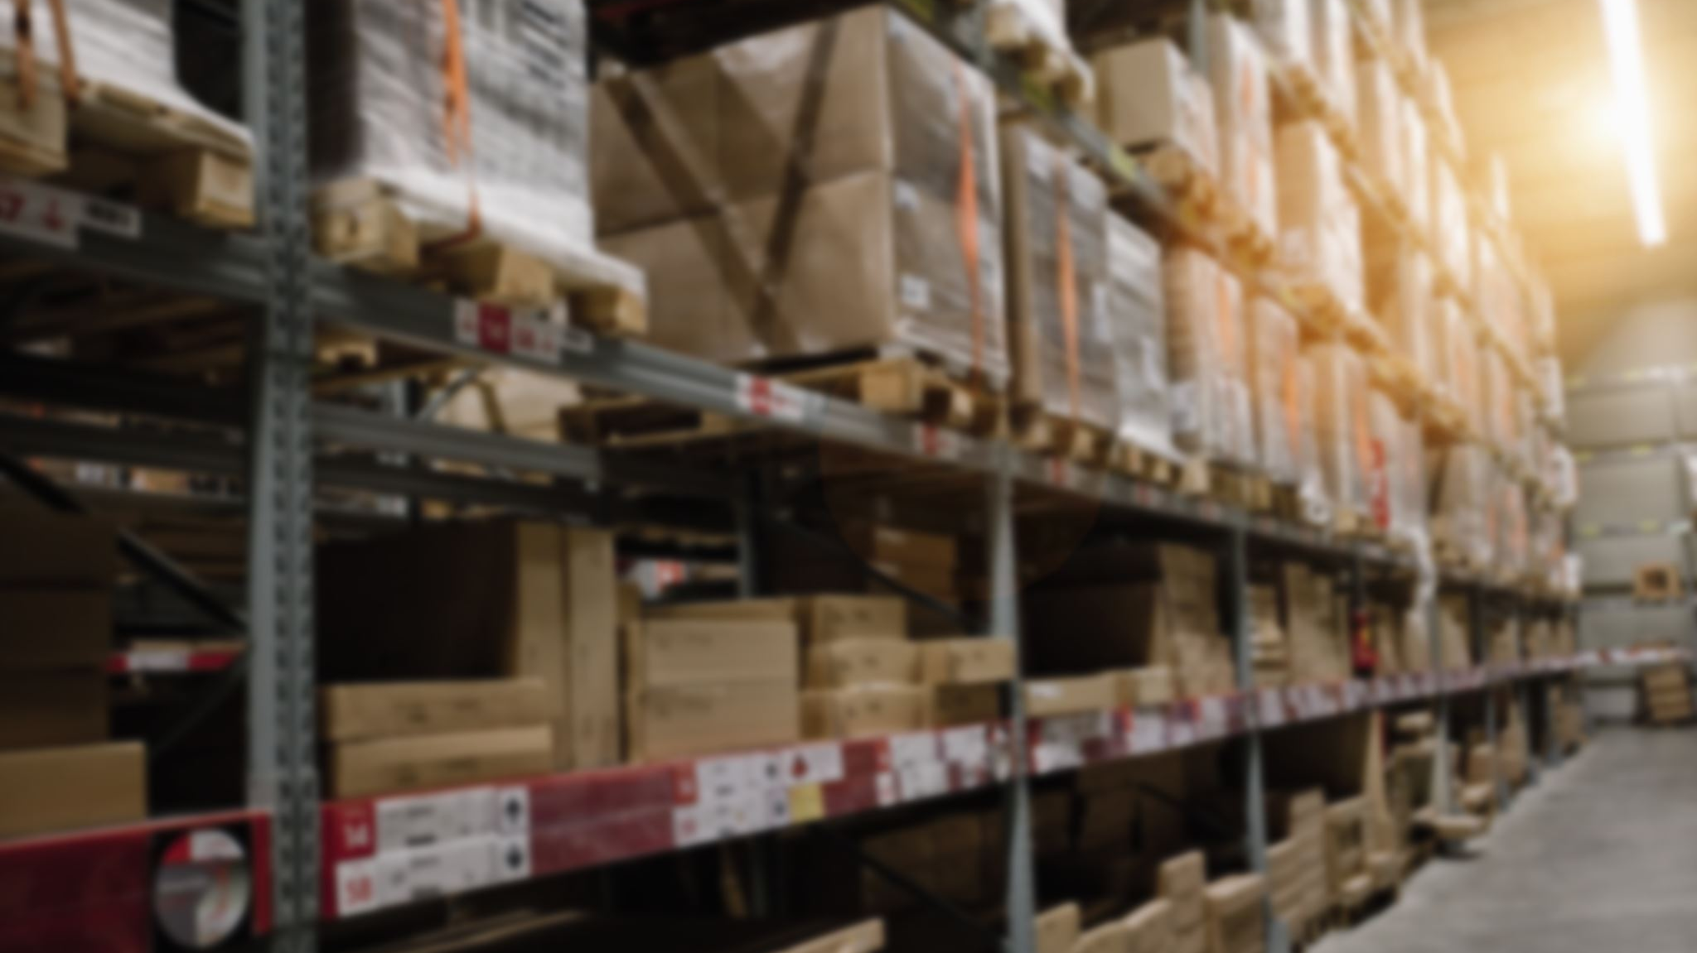
INTRODUCTION
An inventory management system project that allows user to manage and maintain his/her inventory with ease.
The inventory management system has been developed to allow users to add an inventory, delete an inventory, enter inventory quantity and other details, update inventory status and more.

Slide 6

Inventory management tries to efficiently streamline inventories to avoid both gluts and shortages.
It also records the stock currently available in the store.

Slide 7
INVENTORY
Inventory is a complete list of items such as materials, goods in stock.
It is to ensure that there is enough goods or materials to meet demand without creating over stock or excess inventory.
It is also used for a list of the contents of a household.
Inventory or stock refers to the goods and materials that a business holds for the ultimate-goal of resale, production or utilization.

Slide 8
INVENTORY MANAGEMENT
Inventory management is the function of understanding the stock mix of a company and the different demands on that stock.
Inventory management helps companies identify which and how much stock to order at what time. It tracks inventory from purchase to the sale of goods.
Inventory management is important for every other business enterprise.

Slide 9

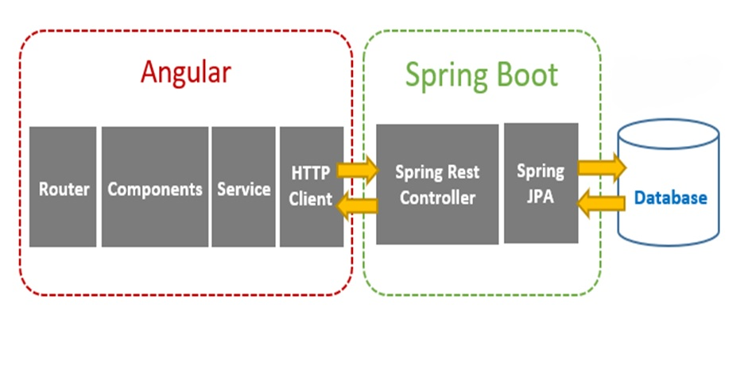
BLOCK DIAGRAM

Slide 10
10
TECHNOLOGIES USED
Front end: Angular Server Side: Spring Boot Back-end: Hibernate, MYSQL Server: Tomcat

Slide 11
Modules
1. User Registration
2. User Login
3. Item Management
4. Purchases Management
5. Sales Management
6. Customer Management

Slide 12
USER MODULE
Register to the application.
Sign into the application to maintain the record of activities.
Search for item by giving item number or item name.
Check the total stock of the item.
Check the sale details.
Fill the customer details by giving name, phone number and address.

Slide 13
REGISTER MODULE
FIELD REQUIRED:
Name
Username
Password
REST API’S:
Login
Register
Reset Password
Clear

Slide 14
LOGIN MODULE
FIELD REQUIRED :
username
password
REST API’S :
add

Slide 15
ITEM MODULE
FIELD REQUIRED :
item number
product id
item name
description
discount%
quantity
unit price
total stock

Slide 16
PURCHASE MODULE
FIELD REQUIRED:
item number
item name
purchase date
purchase id
current stock
vendor name
quantity
unit price
total cost
REST API’S:
add

Slide 17
SALE MODULE
FIELD REQUIRED:
Item Number
Item Name
Customer Name
Customer Id
Sale Id
Sale Date
Total Stock
Discount%
Quantity
Unit Price
Total
REST API’S:
Add

Slide 18
CUSTOMER MODULE
FIELD REQUIRED :
Name
Customer Id
Phone
Phone 2(optional)
Email
Address
City
Pincode
REST API’S PERFORMED :
Add

Slide 19
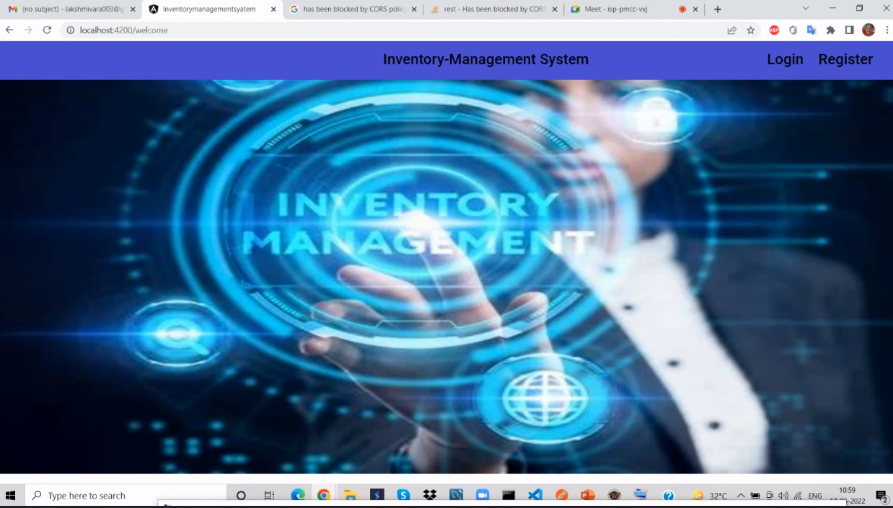

Slide 20
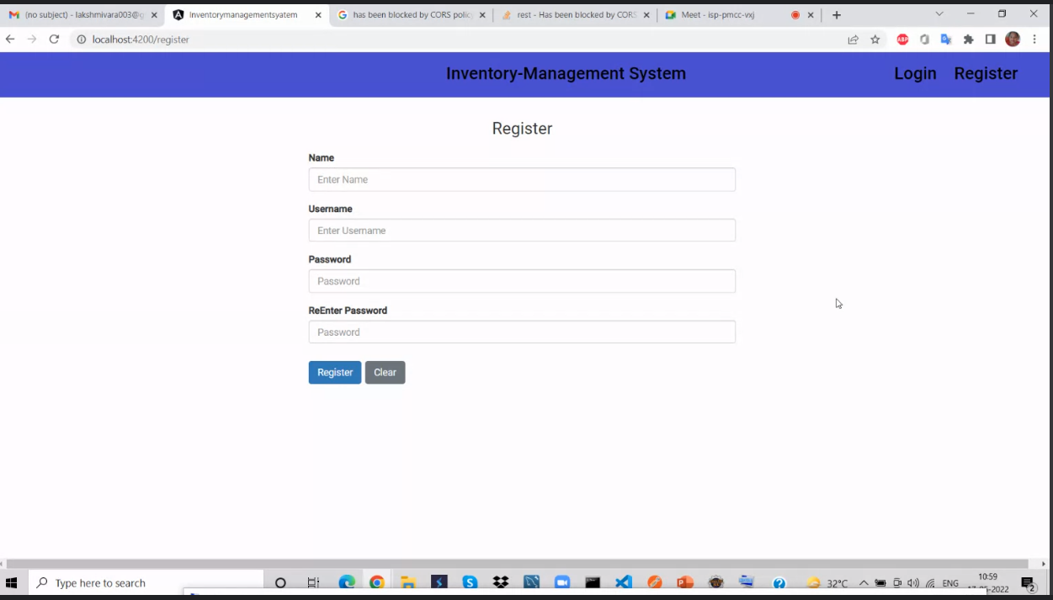

Slide 21
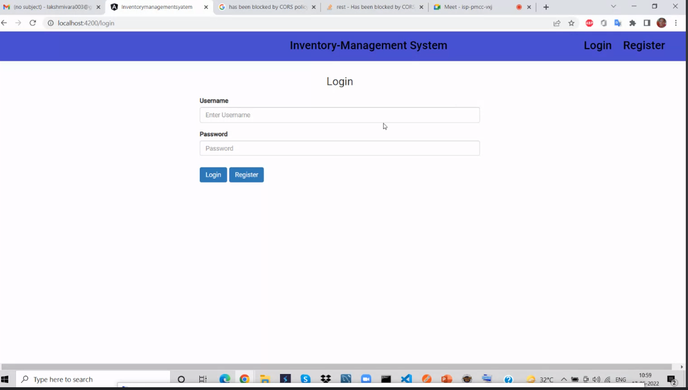

Slide 22
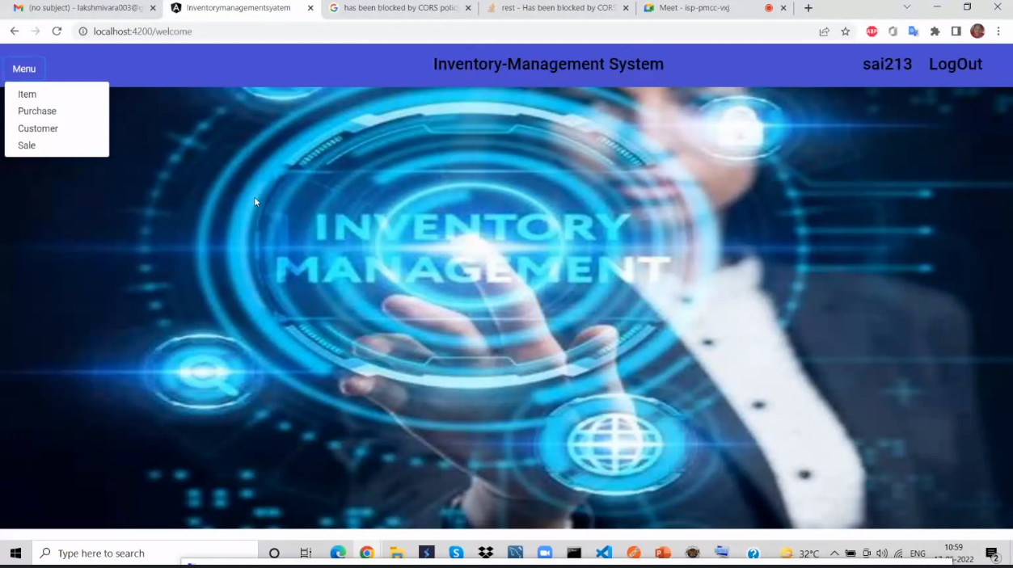

Slide 23
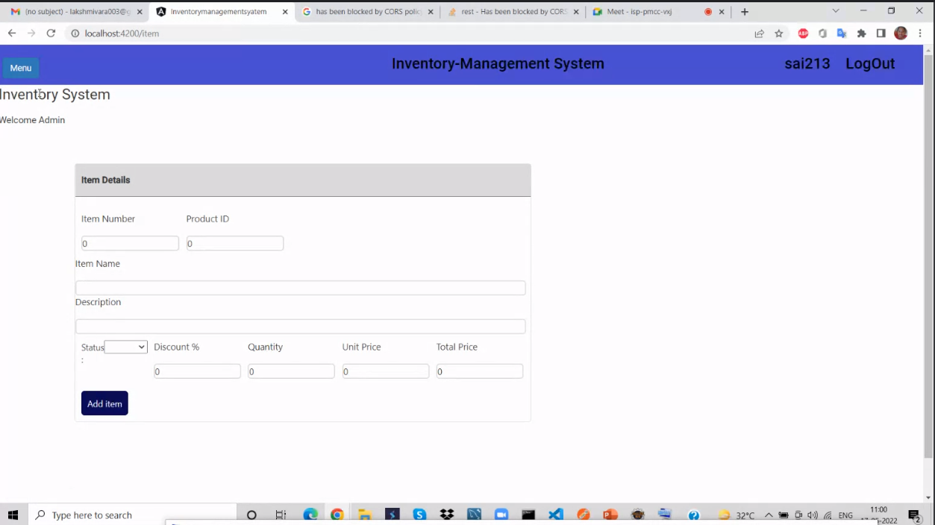

Slide 24
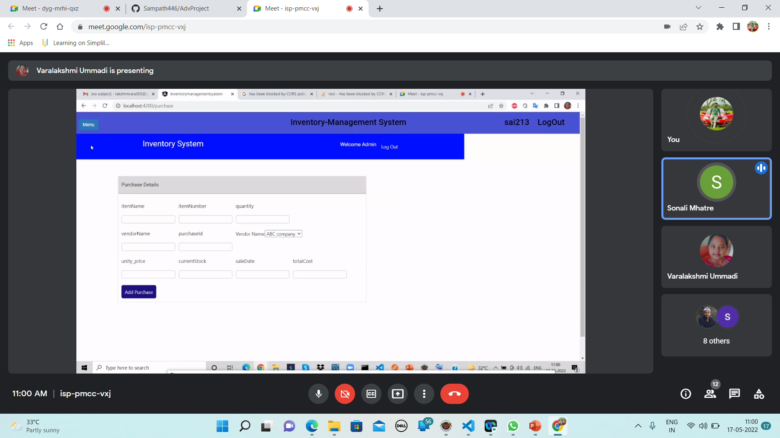

Slide 25
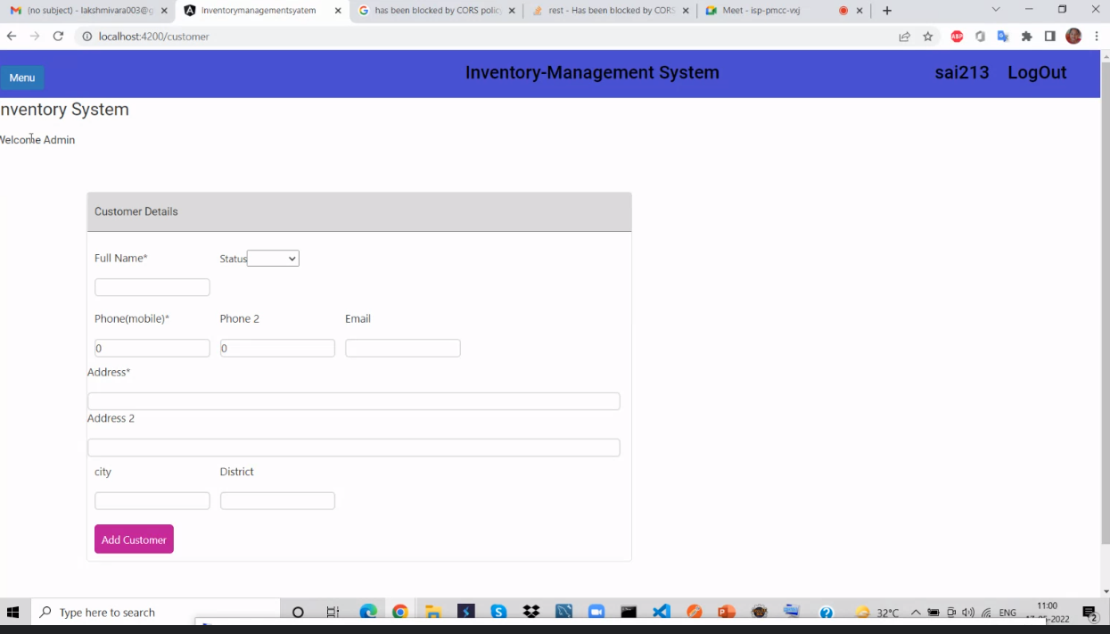

Slide 26
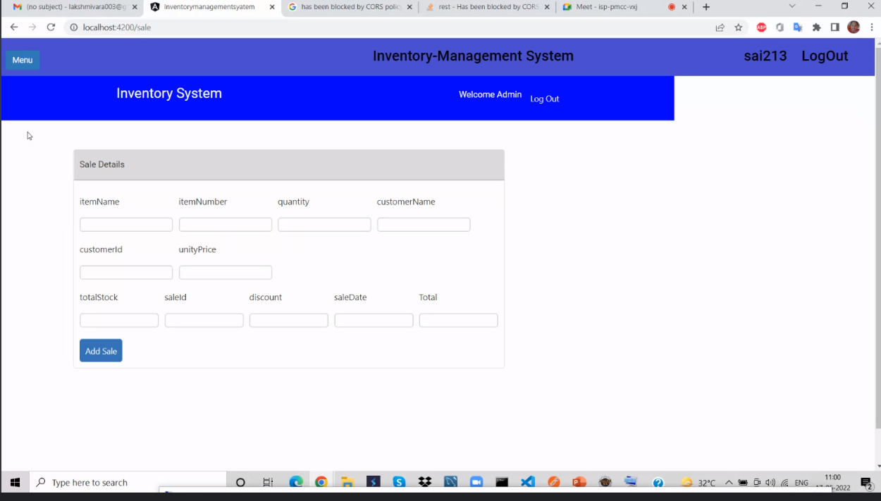

Slide 27
ADVANTAGES
It Reduces Risk of Overselling.
Avoiding Stockouts and Excess Stock.
A More Organized Warehouse.
Better Customer Experience

Slide 28
Importance of Inventory Balance the advantages and disadvantages of small and large inventories
Pressure for Small Inventories:
Inventory holding cost
Cost of capital
Storage and handling costs
Taxes, insurance, and shrinkage

Slide 29
Importance of Inventory Pressures for large inventories Customer service Ordering cost Setup cost Labor and equipment utilization Transportation cost Payments to suppliers

Slide 30
FUTURE IMPLEMENTATION
We can add some more features in future.
We can take feedbacks from the Customers to improve the Customer relationship.
Successful companies will view inventory as a strategic asset, rather than an aggravating expense or an evil to be tolerated.

Slide 31
PROJECT OVERVIEW
This Inventory management system is all about selling and buying products.
It is a simple project that monitors the stock quantity. This system has a pleasant user interface, and it is user-friendly.
The system generates reports for the list of Items, Sales, Customer, and Purchases.

Slide 32
CONCLUSION
Inventory management is important for keeping costs down, while meeting regulations.
Supply and demand is a delicate balance, and inventory management hopes to ensure that the balance undistributed.

Slide 33
THANK YOU

